Slide 1


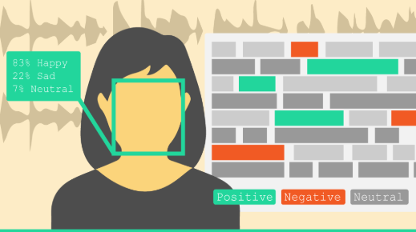

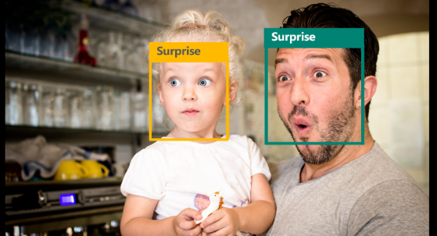
Emotion Detection for IoT Applications
Karina Cuadrado, Morayo Ogunsina, and Kyle Jonas Faculty Advisor: Dr. Asare-Yeboah
Notes:
Kyle:

Slide 2
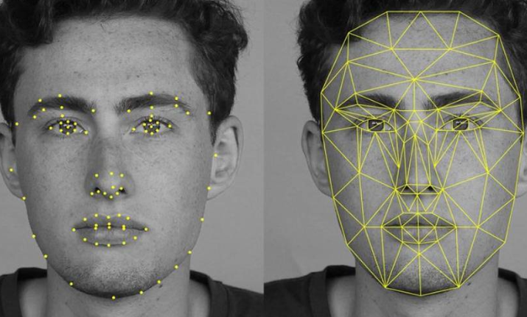
Introduction
Need
System for human-computer interaction with a camera based off emotion
Target applications are in education, security and healthcare
Notes:
Kyle: from human interaction to human-computer interaction

Slide 3
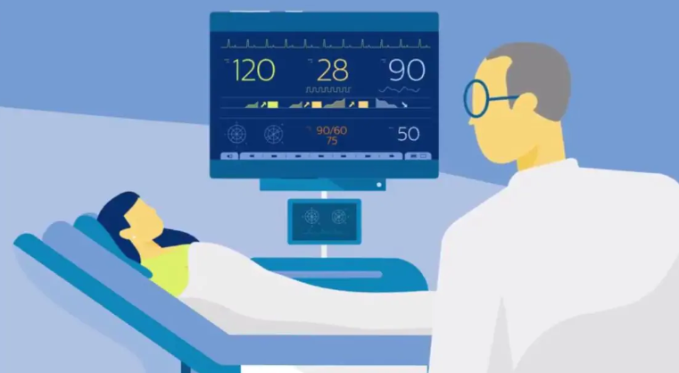
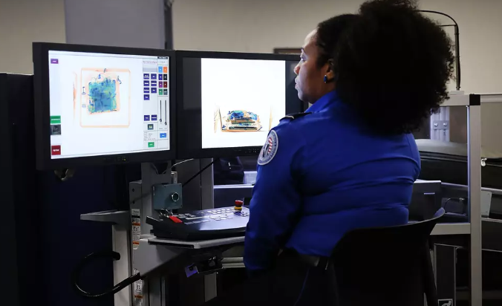
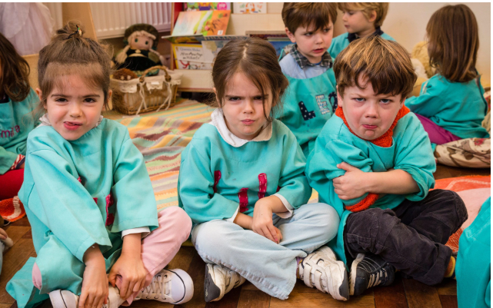
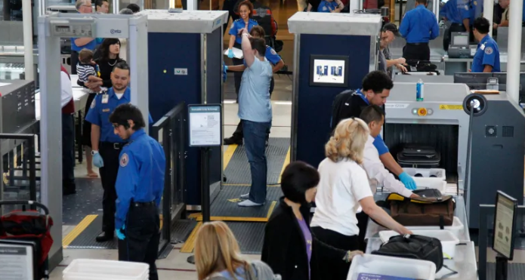
Target Applications
Notes:
Morayo Target Application : Education(Child care and monitoring) and Security(TSA to monitor and observe for potential threats). Healthcare : Healthcare : Patient observation.

Slide 4

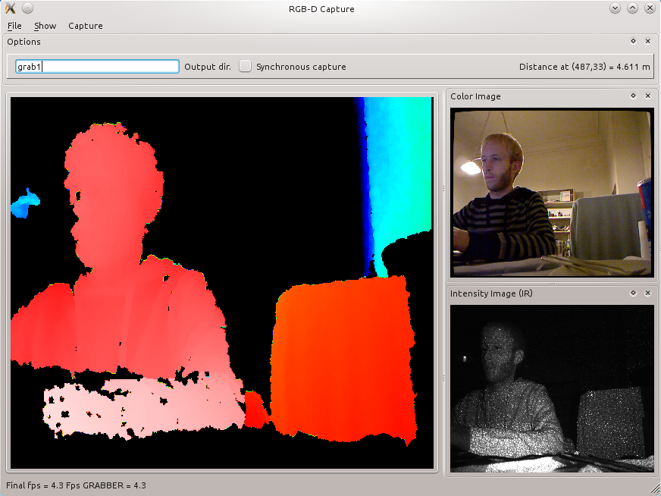
Introduction
Objective
Develop a machine learning algorithm deployed on a portable embedded device to perform emotion classification
Future research
Build a robust dataset for multimodality facial expression research to improve classification performance
Notes:
Morayo:
https://www.groundai.com/project/multimodal-machine-learning-a-survey-and-taxonomy/
https://i-hls.com/archives/88039
Multimodality -> explain better (change image to multimodal), say infra red

Slide 5
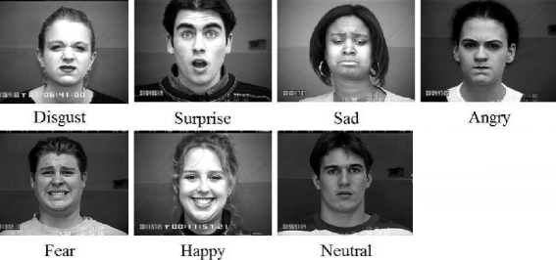
Background
Patterns of facial actions correlate with the basic human emotions.
Automatic facial expression recognition systems consist of:
Image processing
Feature extraction
Classification using machine learning
Notes:
Karina
Image processing -> resizing, converting to grayscale(datasets are in grayscale ) or normalizing the image
Cascadeclassifier -> is fed Haar-like features
https://www.pyimagesearch.com/2018/06/25/raspberry-pi-face-recognition/
https://www.hackster.io/Rjuarez7/raspberry-pi-3-face-detection-in-python-2-and-opencv-2-2b06bf
What the basic emotions are (imotions catalog) - say which are positive and negative

Slide 6
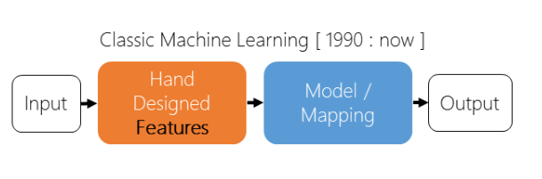

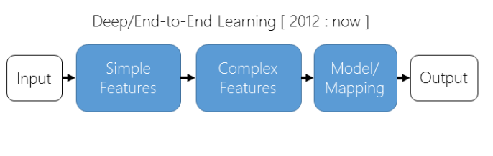
Neural Network Background
Classical
Deep Learning
Notes:
Kyle
AlexNet
NVIDIA Course
Machine learning model references hand designed features
Deep learning feeds images directing into alg
Chamge title to NN background (approaches)

Slide 7
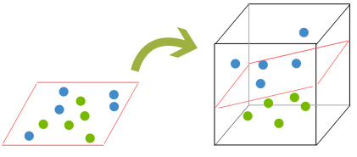
Support Vector Machine Background
Supervised learning alternative
Creates a hyperplane by mapping the data to a higher dimension
Notes:
Karina

Slide 8
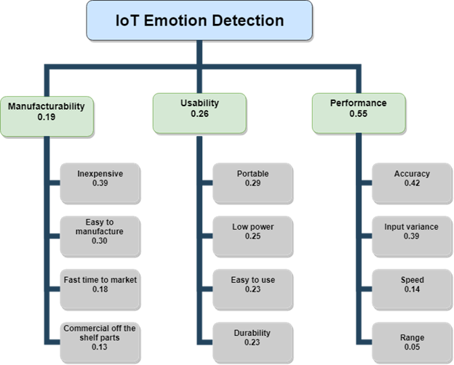
Marketing Requirements
Notes:
Morayo
Mention main categories
Most important: inexpensive portable and accuracy
Explain each highlevel category, then dig into each

Slide 9
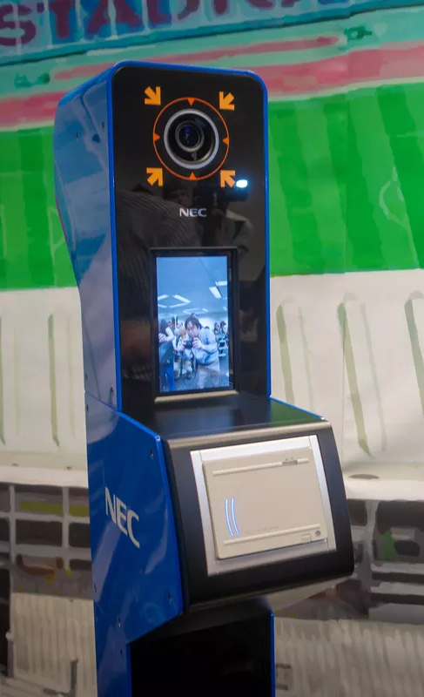
Engineering Requirements
System prototype cost under $100 [negotiated]
Weight under 3 lb
85% accuracy
6 hours of operation time
System response must be under 3 seconds
Send: 2 frames of 256x256 RGB image/sec
Receive: Image category 0-6
10 ft detection range
Portable
Wireless connection
Notes:
Karina
https://notenoughtech.com/raspberry-pi/raspberry-pi-3b-plus-network-speed/ https://www.phoronix.com/scan.php?page=article&item=raspberry-pi3bplus-wifi&num=2
https://www.scantips.com/basics1d.html
131,072 Bytes, 0.125 MB, 2 bytes per pixel
Revise or take off bandwidth requirements…. We got a lot of shit for it last time

Slide 10
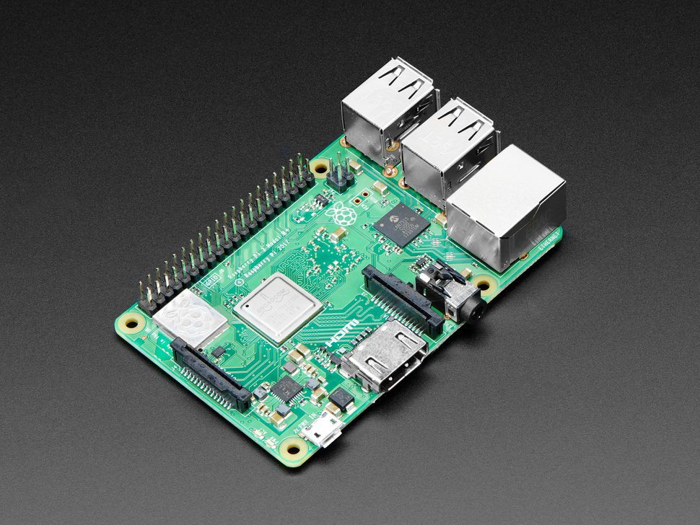
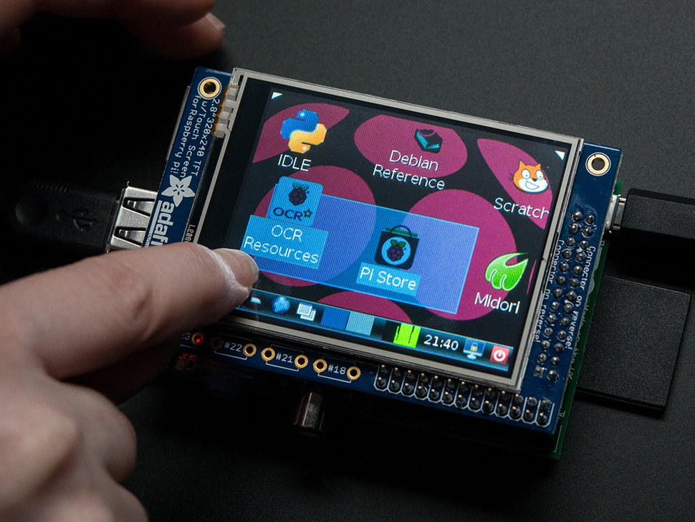
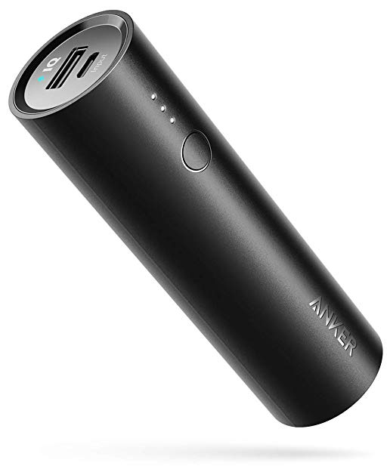
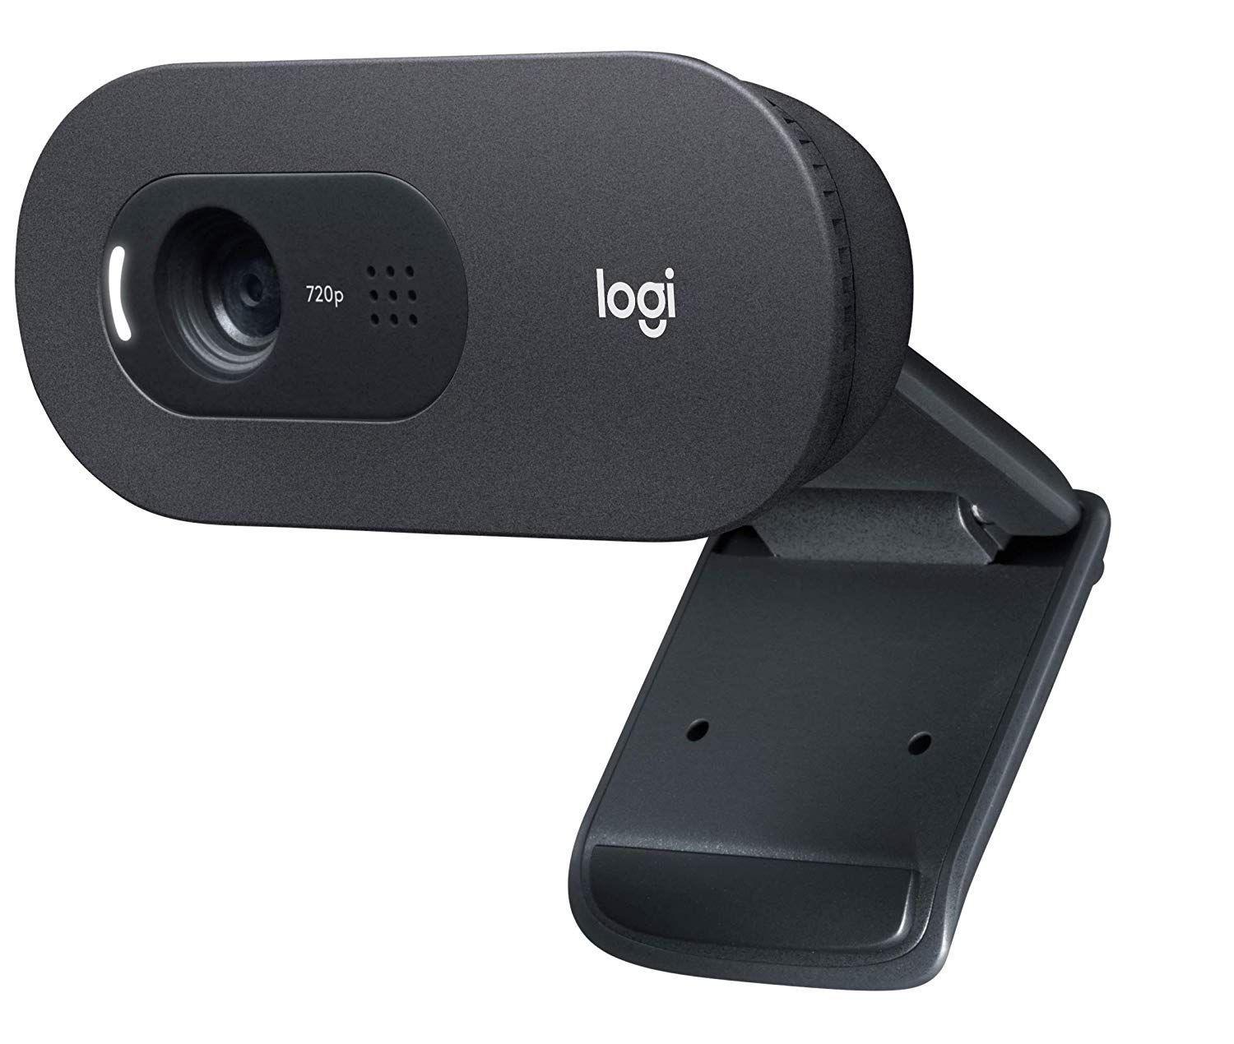
Hardware Components
Raspberry Pi Model 3 B+: $35
Built-in Wireless Card:
Cypress CYW43455
2.4 / 5 GHz 802.11.b/g/n/ac
Adafruit PiTFT: $35
Size: 320x240
5000mAh Battery: $22
Duration: ~6.7 h
Logitech C270: $20
Resolution:
640x480 @ 30 FPS
Total: $112
Notes:
Kyle
Wifi 55 Mb/s over 2.4GHz
100 Mb/s over 5GHz
https://spellfoundry.com/raspberry-pi-battery-runtime-calculator/

Slide 11
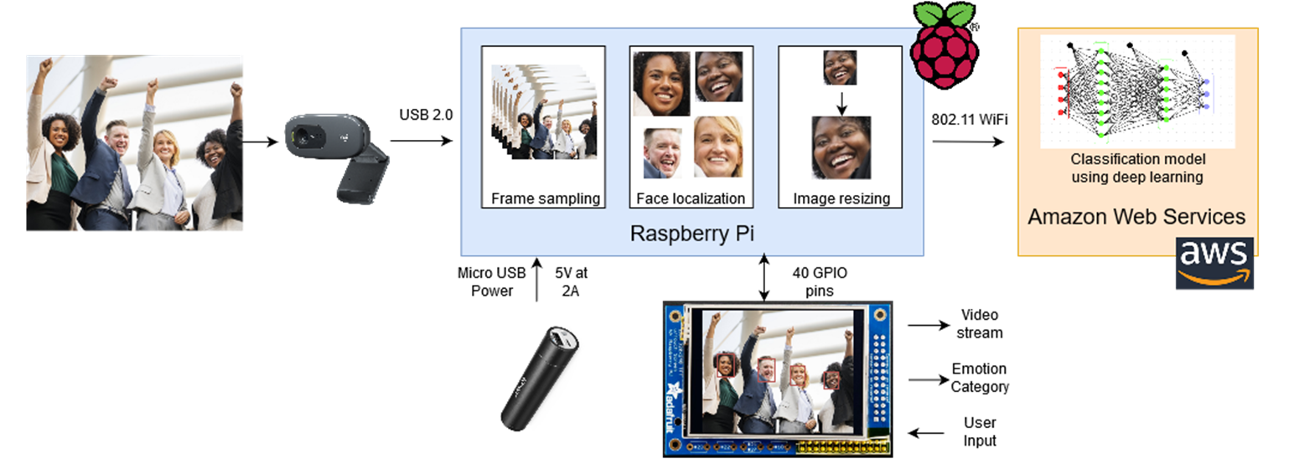
System Level Design
Notes:
Karina
Ideal system -> make sure to mention that

Slide 12
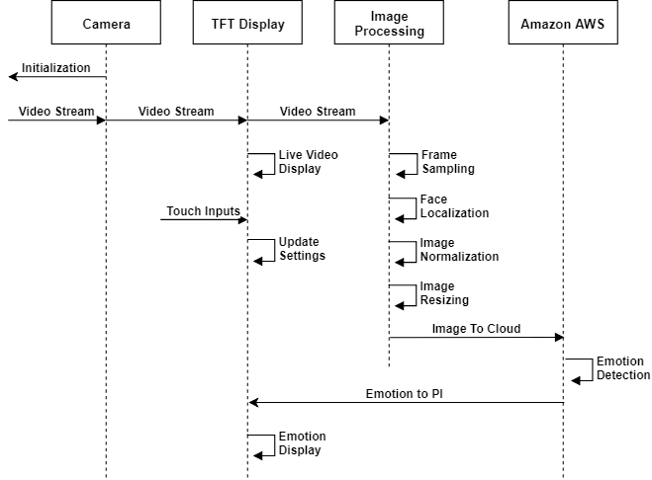
Sequence Diagram
Notes:
Morayo

Slide 13
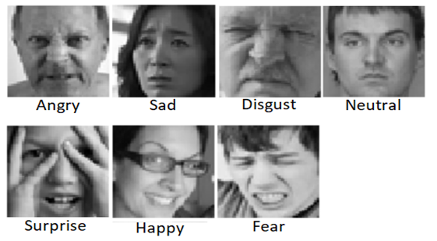
Training Datasets
FER2013 dataset
35,887 images
48x48 resolution
All Grayscale Figure: FER2013 Dataset
Nose Aligned Cohn-Kanade (CK)
175 Images
640x480 resolution
Figure: Cohn-Kanade (CK) Dataset
Notes:
Morayo -
Image properties -> size (downsampling), filtering, wavelets, etc.
Features fed to NN ->

Slide 14
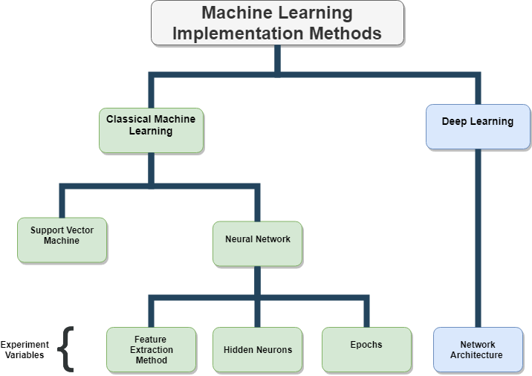
Notes:
Kyle

Slide 15
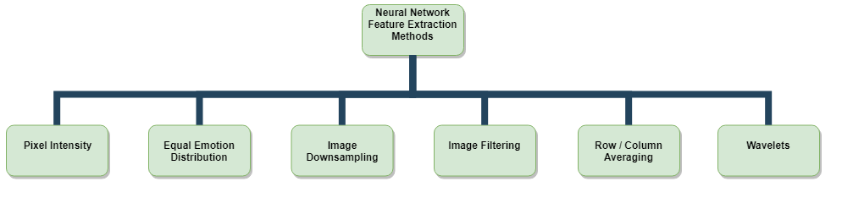
Neural Network Feature Extraction Methods
Notes:
Karina

Slide 16
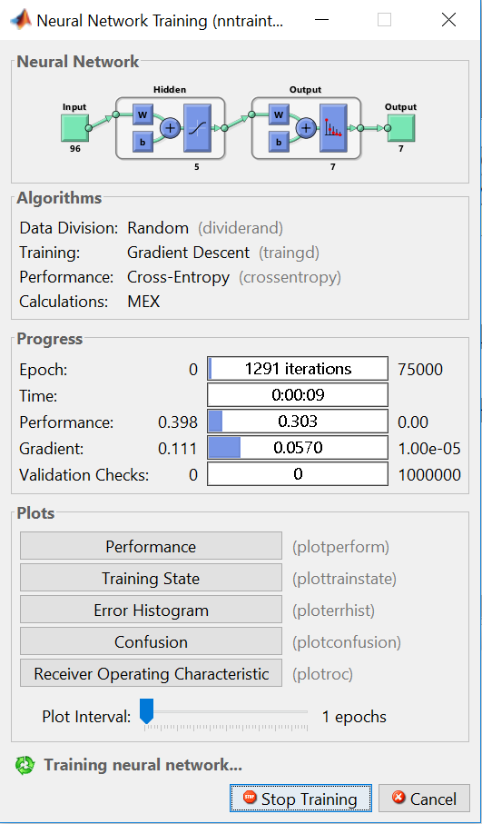
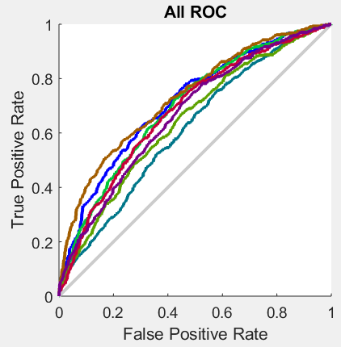
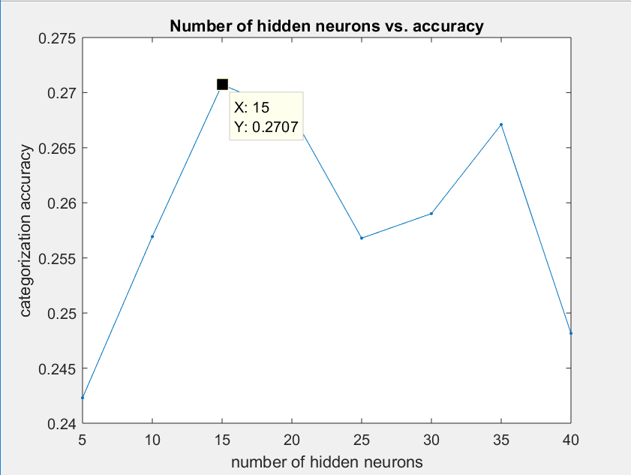
MATLAB Neural Network Toolkit + FER2013 Dataset
Graph: Accuracy per hidden neurons
Graph: Receiver Operating Characteristics
Notes:
Morayo
Dataset partition
[train,validation,test]: 70%, 15%, 15%
Epoch -> ENTIRE dataset is passed forward and backward through the neural network only ONCE.
Gradient -> gradient of mean squared error (difference between dataset targets and predictions)

Slide 17
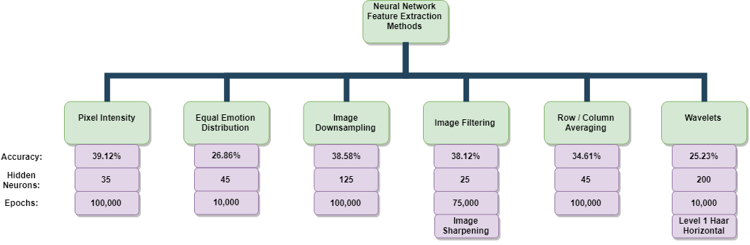
Neural Network Experimental Results
Notes:
Morayo

Slide 18
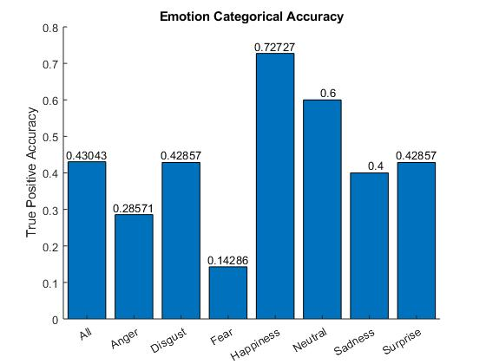
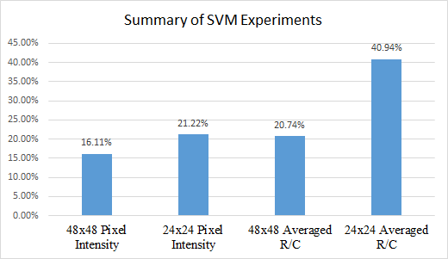
Classical Machine Learning: Support Vector Machine
Repeated neural networks experiments using SVM
Highest accuracy: 43.04% using 160x120 pixel intensity values of CK dataset
Figure: 160x120 emotion category accuracies
Figure: Summary of SVM models results for FER2013
Notes:
Karina

Slide 19
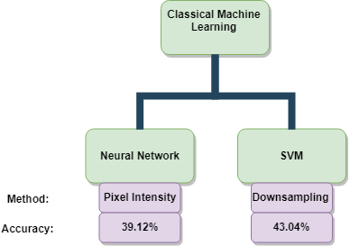
Classical Machine Learning Results
Notes:
Morayo

Slide 20
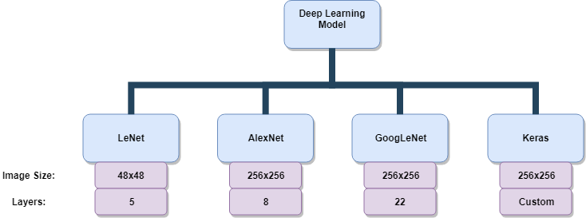
Deep Learning Models
Notes:
Kyle/Karina

Slide 21





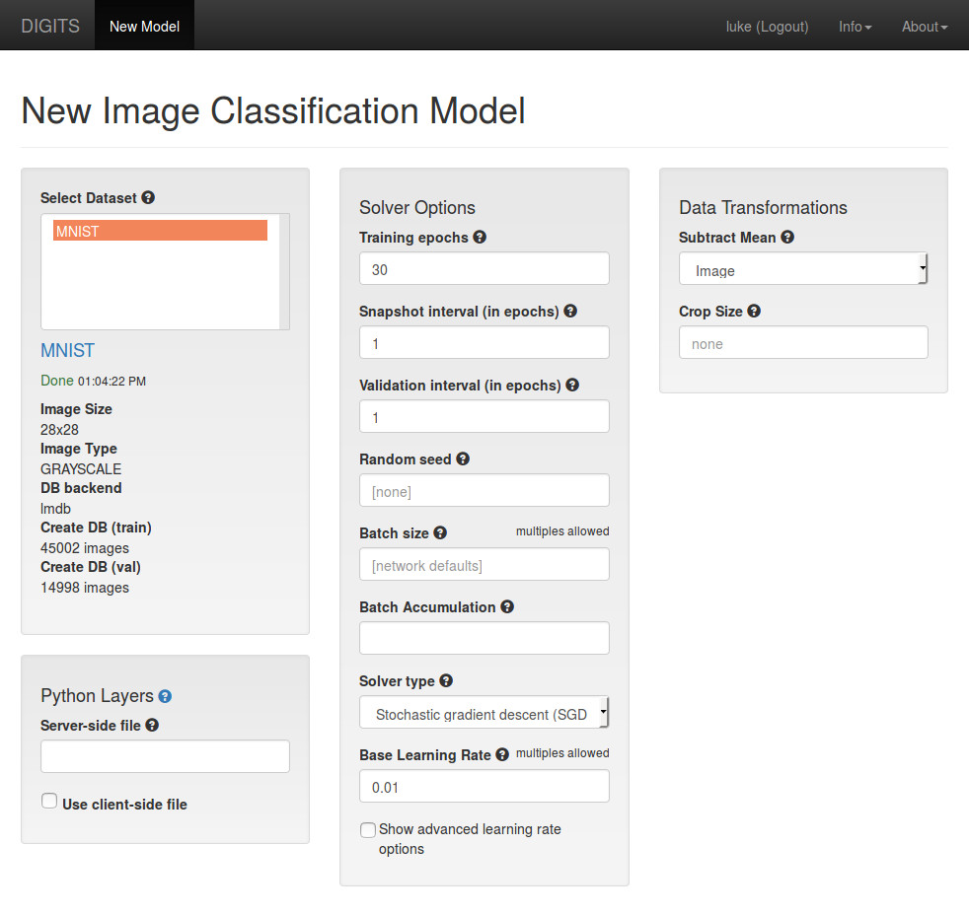
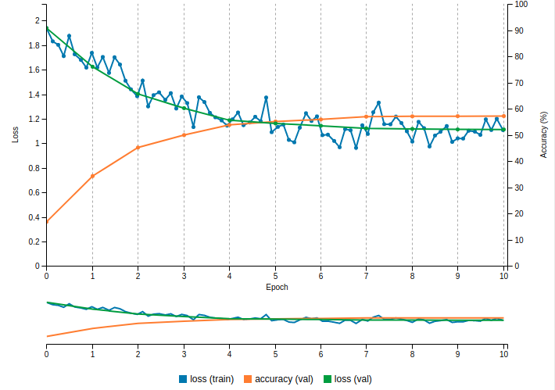
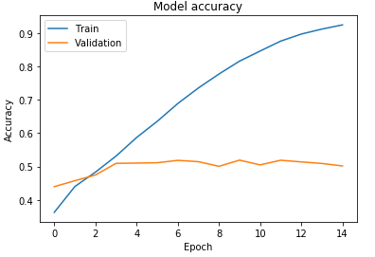
Deep Learning
NVIDIA DIGITS
Wrapper for Caffe, Torch, and TensorFlow
Graphical web interface
Keras API
Figure: Model setup
Graph: Digits training performance
Graph: Keras training performance
Notes:
Kyle / Karina
Caffe / TensorFlow
Leverage GPU power on cloud or local system

Slide 22
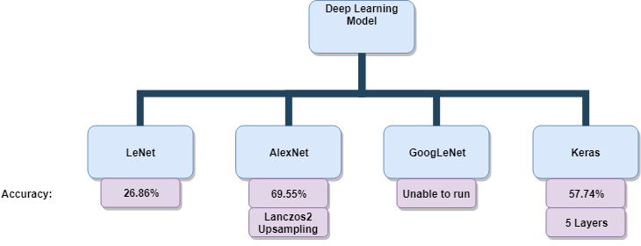
Deep Learning Results
Notes:
Kyle/Karina

Slide 23
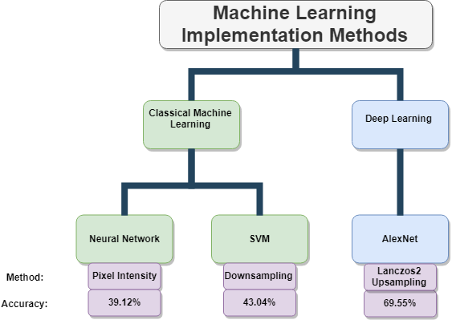
Machine Learning Results
Notes:
Kyle

Slide 24
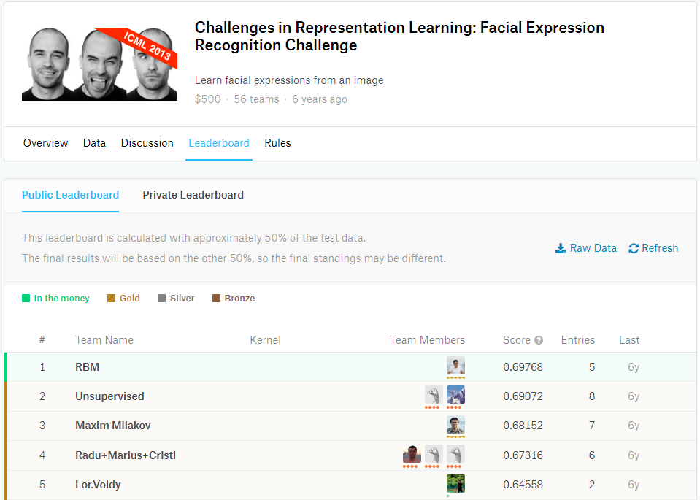
FER2013 Results Perspective
Where we place
69.55%
2nd in competition
0.22% away from 1st
Where to go from here
Cloud deployment
Improved data set
Notes:
Kyle

Slide 25
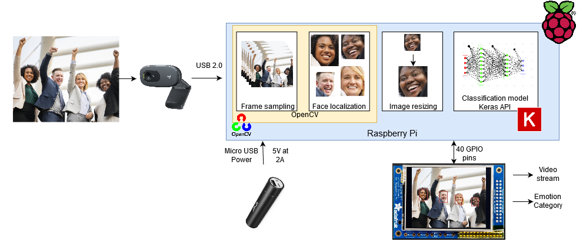
Proof of Concept: System Design
Notes:
Karina
Why we could run the keras but not the others
Find optimal angle and lighting

Slide 26
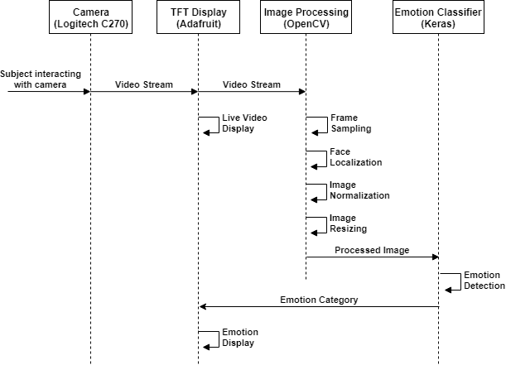
Proof of Concept: Sequence Diagram
Notes:
Morayo
Only difference lies in the deployment environment and library used (keras?)

Slide 27
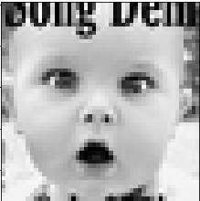
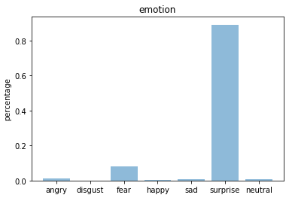
Proof of Concept: Deployment
Why Keras model?
Hardware constraints
Deep Learning GPU focus
What to expect from 57% accuracy?
Not in terms of live detection accuracy
Doesn’t suit the intended deployment application
Figure: Model prediction
Notes:
Kyle

Slide 28
DEMO
Notes:
Morayo
Using Opencv (open source library for comp vis) to capture ,
face classifier library to identify faces and mark roi ,
and pass to keras trained model of 57%, and prints the predicted emotion to the screen

Slide 29
Conclusions
Deep Learning advantages over classical machine learning
Deep Learning: 69.55% using Lanczos2 upsampling
SVM: 43.04% using 160x120 pixel intensity values
Positive emotions more accurate than negative emotions
Algorithm deployment dependent on system hardware
Future Improvements
Build and Implement multi-modal dataset to improve detection rate
Notes:
Morayo

Slide 30

Questions

